Slide 1
Fick’s Law of Diffusivity
Ramiro Roman
Jesse Anderson

Slide 2
Problem Statement and Motivation
To quantitatively understand Fick’s Law of Diffusivity and its applications.
Explore various ways of modeling the law and the advantages and disadvantages of each.
Explore the evolution of diffusion over time and steady state values.
Compare diffusion and heat transfer calculation methods.
Testing implementations in MATLAB, Julia, Python, and VBA for Excel.

Slide 3
What is Fick’s Law of Diffusivity?
Developed by physiologist Adolf Fick in 1855.
Diffusion of a substance across a material is proportional to the concentration gradient of the substance in the material.
Applications exist in Physics, Chemistry, and Biology.
Chemical Engineering: Gas absorption, adsorption, and distillation, catalysis.
Biophysics: Diffusion of molecules across cell membranes such as O₂and CO₂ in the lungs

Slide 4
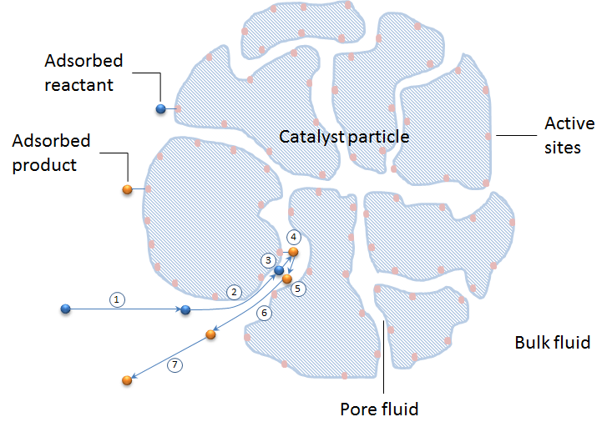
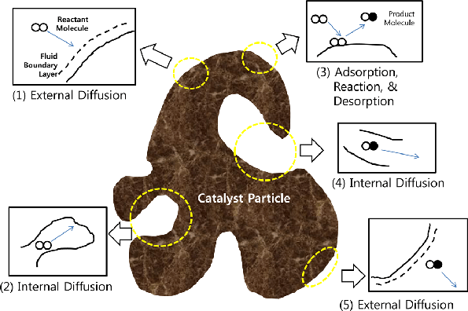
Applications: Diffusion of Chemical through Catalyst [2,3]

Slide 5
Fick’s Law of Diffusivity Mathematically
J = -D (ΔC/Δx) [1]
J = flux or rate of diffusion of the substance(mass or moles per unit area per unit time)
D = Diffusion coefficient or diffusivity of substance(units of length squared per unit time)
ΔC = Concentration gradient of the substance(units of mass or moles per unit volume)
Δx = distance over which the concentration gradient exists(units of length)
The negative sign indicates that diffusion occurs from regions of higher concentration to regions of lower concentration.
Assumptions of the law: Substance is in a uniform, isotropic, stationary medium and that no external forces are acting on it.

Slide 6
Derivation of the heat equation
1D[x axis]:
J(x,t) = -D * dC/dx
C(x,t) = concentration of substance at position x and time t.
J(x,t) = flux of substance at position x
dC/dt = -dJ/dx
Conservation of mass: rate of change of concentration is equal to net flux into or out of small volume x
Substitute Fick’s law into conservation of mass equation:
dC/dt = D * d^2C/dx^2
This is the one dimensional equation. To get the 2 dimensional equation we can generalize it by replacing the second derivative with the Laplacian operator.
2D[x,y axis]:
dC/dt = D * ∇^2C
∇^2C is the Laplacian of the concentration field C
Mathematical Computer Science

Slide 7
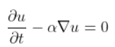
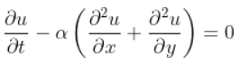
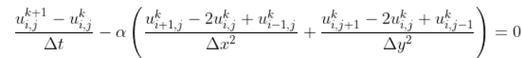
Discretization Step [4]

Slide 8
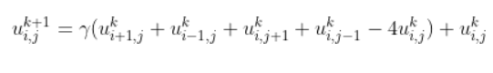
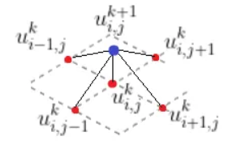
Discretization Step (Cont.)

Slide 9
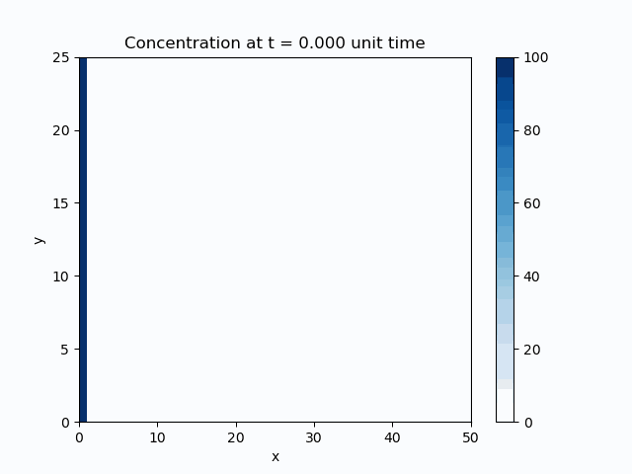
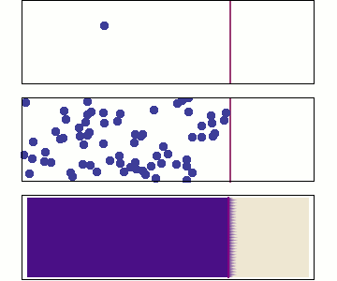
Plots
“Reproduce the illustration on the wikipedia page on Fick’s laws of diffusion.” [1]

Slide 10
Conclusions
Creating the image using a large number of randomly moving particles is possible, yet recoursefully expensive
Implementing discretization is a better way to generate our image
Different libraries need to be explored in order to create a cleaner image

Slide 11
Supplemental

Slide 12
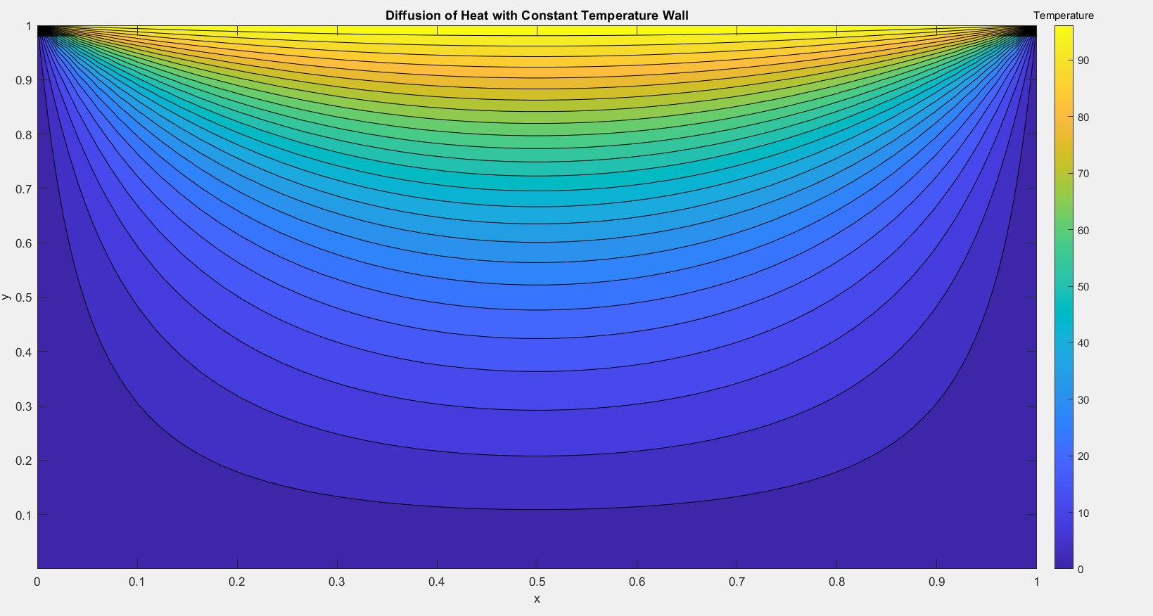

Slide 13
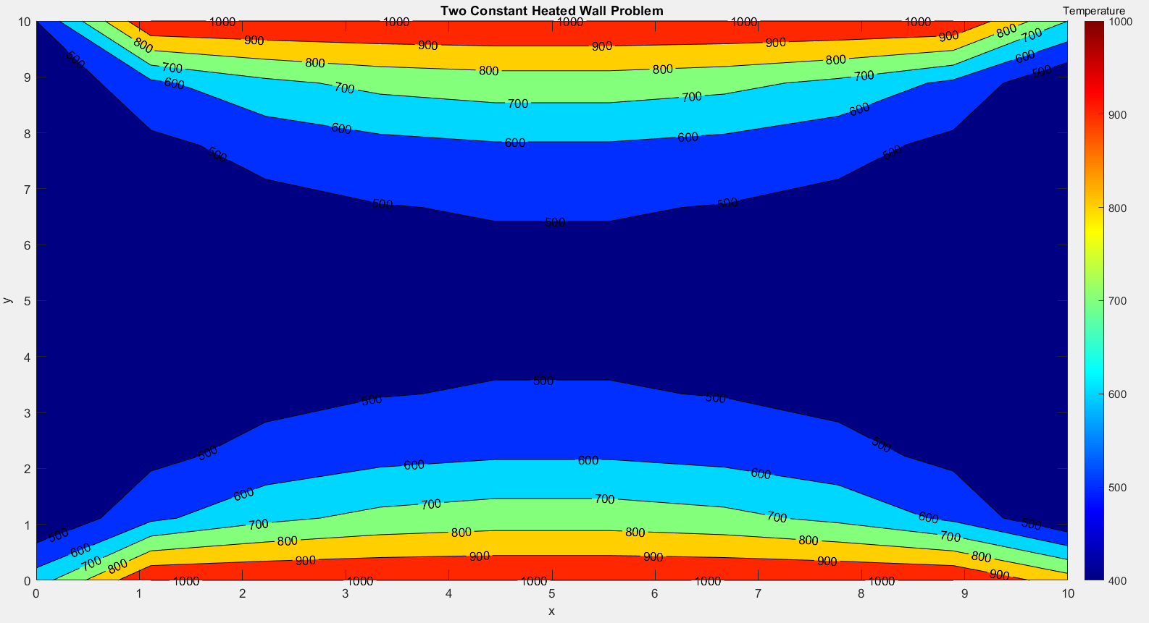

Slide 14
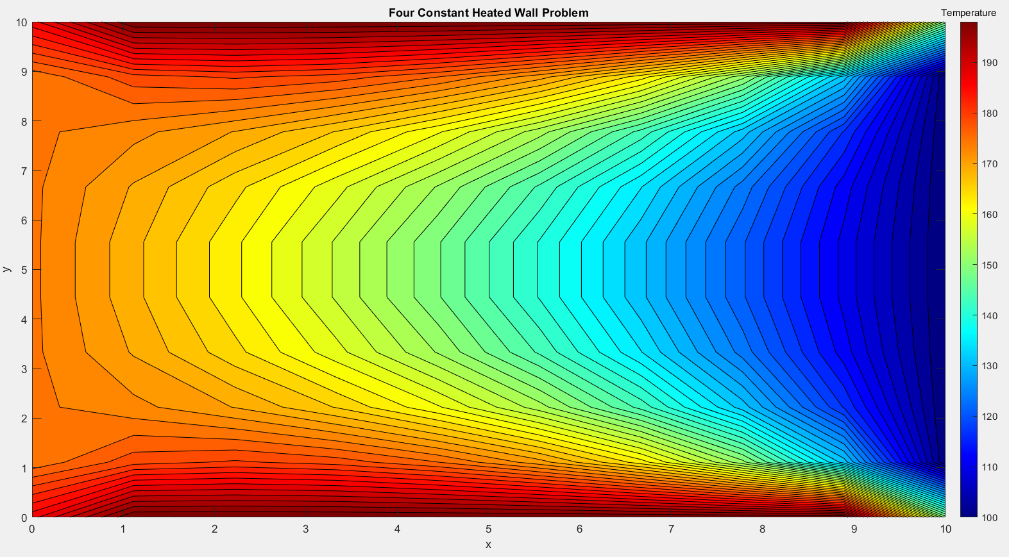

Slide 15
References
[1] Wikimedia Foundation. (2023, April 19). Fick's laws of diffusion. Wikipedia. Retrieved April 26, 2023, from https://en.wikipedia.org/wiki/Fick%27s_laws_of_diffusion
[2] Philibert J (2005). "One and a Half Centuries of Diffusion: Fick, Einstein, before and beyond" (PDF). Diffusion Fundamentals. 2: 1.1–1.10. Archived from the original (PDF) on 5 February
[3] Williams FA (1985). "Appendix E". Combustion Theory. Benjamin/Cummings.
[4] Nosek TM. "Section 3/3ch9/s3ch9_2". Essentials of Human Physiology. Archived from the original on 24 March 2016.

